Slide 1


Progress report on PIC simulations of a neutralized electron beam
James Gerity, Texas A&M University
Presented at JLEIC Fall collaboration meeting October 6, 2016
Slides available at http://www.github.com/jgerity/talks

Slide 2
Electron cooling
Coulomb collision with ‘cold’ electrons drives velocity profiles to equilibrium
Effect is enhanced by magnetization
Ion beam seen from stationary (lab) frame
Ion beam seen from moving frame, with electrons

Slide 3
Motivation
Bunched cooling is desirable to control IBS
Many challenging R&D tasks are involved!
Conventional cooling is part of the baseline
Any improvements to cooling would be beneficial
RadiaSoft and TAMU collaboration

Slide 4
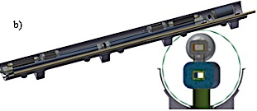
Cooling + stacking ring
Previously proposed: integrate a dedicated ring for cooling + stacking in the existing cryostat layout
Cooling ring
Common cryostat
Collision ring

Slide 5
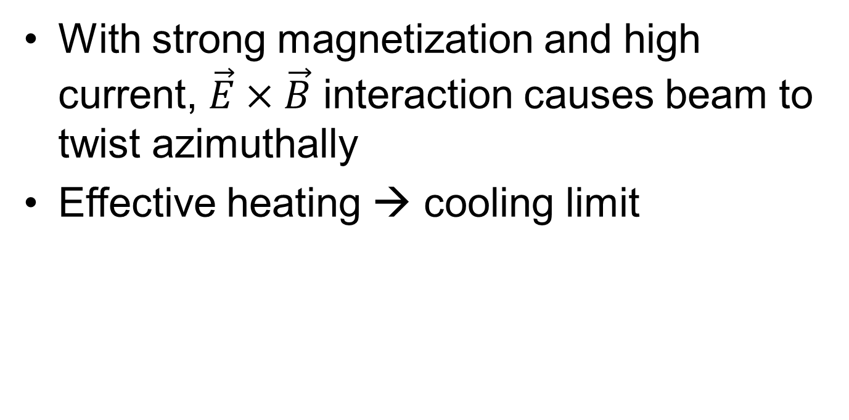
Space charge drift limit
With strong magnetization and high current, $\vec{E}×\vec{B}$ interaction causes beam to twist azimuthally
Effective heating → cooling limit

Slide 6
Fermilab experiments (neutralization)
Initial cooling experiments at Fermilab included ionization of residual gas
Magnetized beam at 1 kG
Space charge compensation also allowed for low-power collection of electrons

Slide 7
Particle-in-cell (PIC) simulation
We have chosen to use the Warp PIC library for this work
Python interface allows rapid simulation development, analysis
No speed compromise, heavy lifting done in Fortran

Slide 8
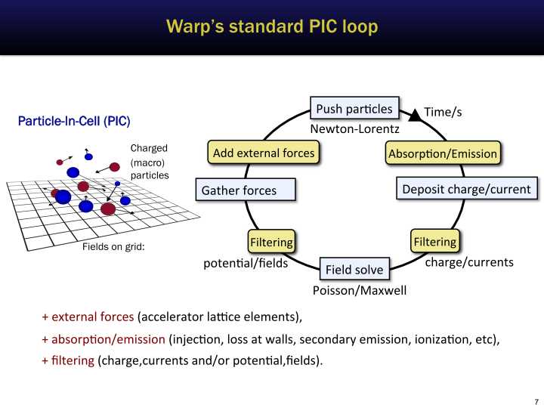
Slide courtesy of J.L. Vay from https://people.nscl.msu.edu/~lund/uspas/scs_2016/

Slide 9
Misc. development
Tools for working with Warp:
Extracting particle data from HDF5 files, converting velocities to angles, etc.
Ionization class extension, allowing arbitrary emission energies
Diagnostic output of fields/particles according to OpenPMD specification for offline analysis

Slide 10
Simulation parameters
116 keV electron beam, 10 mA
1 meter drift as domain
Background H₂ gas with realistic ionization cross-section
In this work, density chosen to observe compensation reasonably quickly
Available on GitHub
https://github.com/radiasoft/rscooler/

Slide 11
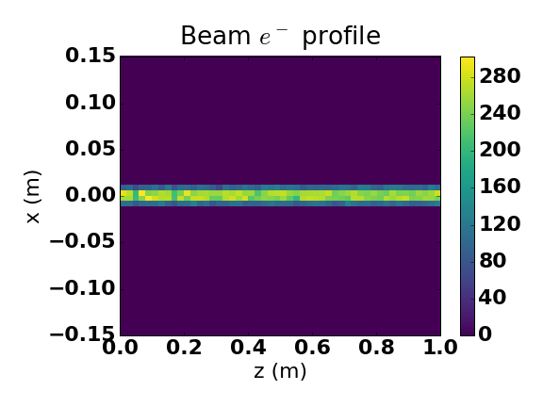

Slide 12
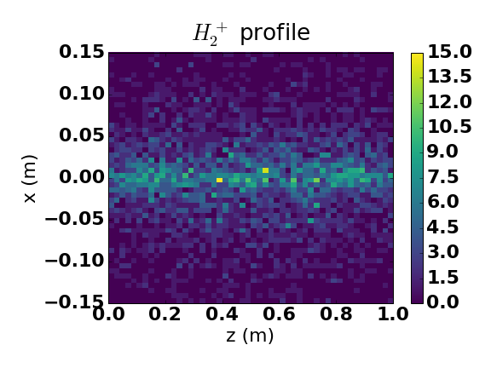

Slide 13
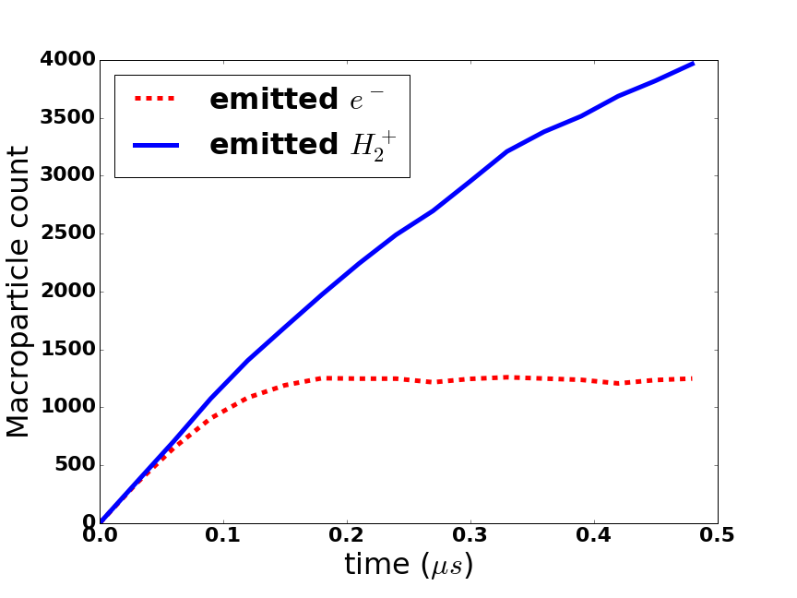

Slide 14
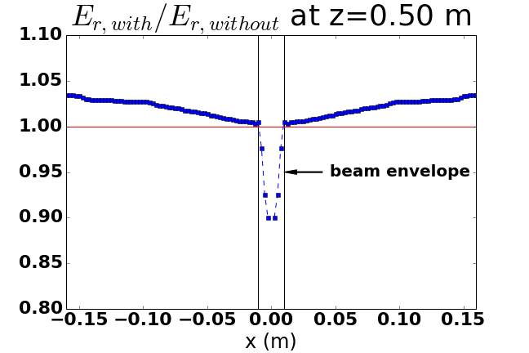
Field suppression at center of beam

Slide 15
Further work
Scale up current, aiming for ~ Ampere
Use of NERSC likely
Replicate Fermilab beam properties
“Electron wind” instability
Quantify dynamic friction for use in long-term study

Slide 16
Thank you!

Slide 17
Backup Slides

Slide 18
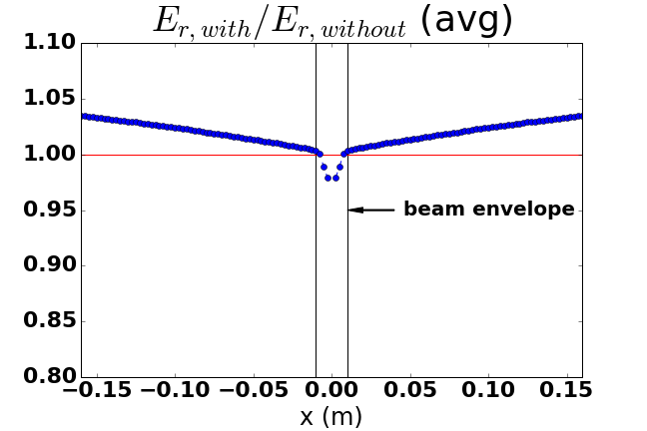
Averaged field suppression

